Slide 1
Ressearch on benefits on higher electrode count on HD-EMG

Slide 2
Is more better?
Yes and no
TL;DR
More will always be more precise
Diminishing returns
Algorithm dependant

Slide 3
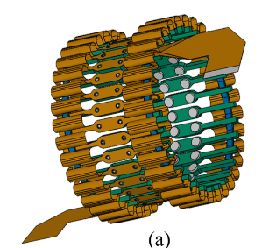
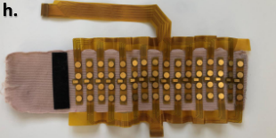
Main focus of articles
Main focus of articles on HD-EMG: Reaching optimal number of electrode for algorithm, not density
F. Chamberland et al., « Novel Wearable HD-EMG Sensor With Shift-Robust Gesture Recognition Using Deep Learning », IEEE Trans. Biomed. Circuits Syst., vol. 17, nº 5, p. 968‑984, oct. 2023, doi: 10.1109/TBCAS.2023.3314053.
G. Rolandino, C. Zangrandi, T. Vieira, G. Luigi Cerone, B. Andrews, et J. J. FitzGerald, « HDE-Array: Development and Validation of a New Dry Electrode Array Design to Acquire HD-sEMG for Hand Position Estimation », IEEE Trans. Neural Syst. Rehabil. Eng., vol. 32, p. 4004‑4013, 2024, doi: 10.1109/tnsre.2024.3490796.

Slide 4
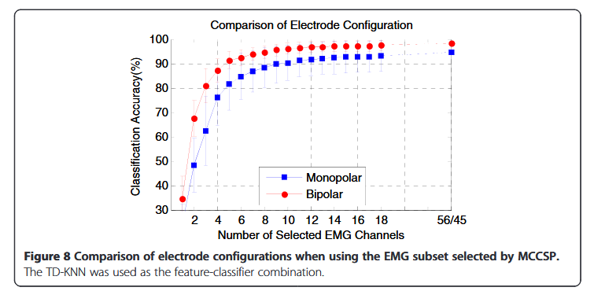
Y. Geng, X. Zhang, Y.-T. Zhang, et G. Li, « A novel channel selection method for multiple motion classification using high-density electromyography », BioMed Eng OnLine, vol. 13, nº 1, p. 102, déc. 2014, doi: 10.1186/1475-925X-13-102.
21 hand movements
Note: Some electrodes are on the hand for this study

Slide 5
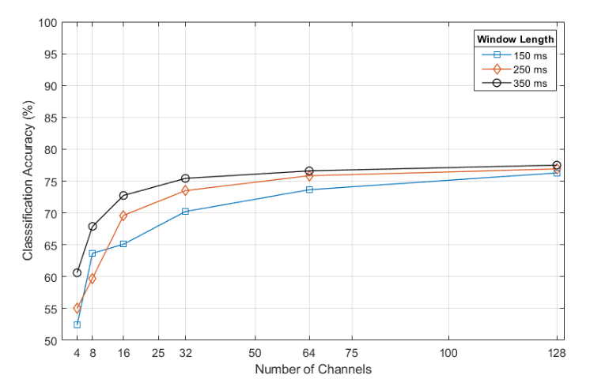
J. Lara, N. Paskaranandavadivel, et L. K. Cheng, « Effect of Segmentation Parameters on Classification Accuracy of High-Density EMG recordings », in 2019 41st Annual International Conference of the IEEE Engineering in Medicine and Biology Society (EMBC), Berlin, Germany: IEEE, juill. 2019, p. 6229‑6232. doi: 10.1109/EMBC.2019.8856809.
9 hand movements

Slide 6
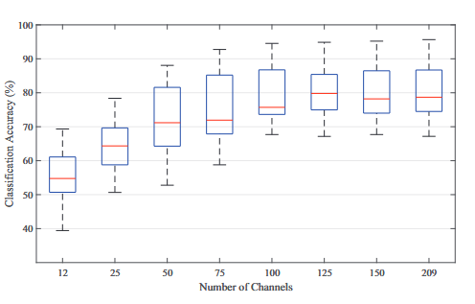
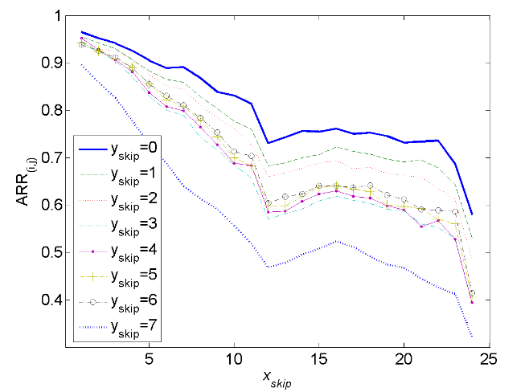
J. Lara, N. Paskaranandavadivel, et L. K. Cheng, « HD-EMG Electrode Count and Feature Selection Influence on Pattern-based Movement Classification Accuracy », in 2020 42nd Annual International Conference of the IEEE Engineering in Medicine & Biology Society (EMBC), Montreal, QC, Canada: IEEE, juill. 2020, p. 4787‑4790. doi: 10.1109/EMBC44109.2020.9175210.
M. Paleari, M. Di Girolamo, N. Celadon, A. Favetto, et P. Ariano, « On optimal electrode configuration to estimate hand movements from forearm surface electromyography », in 2015 37th Annual International Conference of the IEEE Engineering in Medicine and Biology Society (EMBC), Milan: IEEE, août 2015, p. 6086‑6089. doi: 10.1109/EMBC.2015.7319780.
17 hand movements
11 hand movements

Slide 7
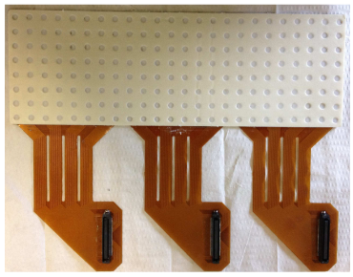
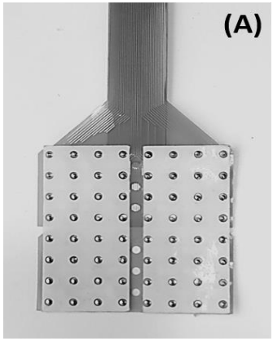
Consequence of main focus
Use of commercial hardware
If focused on quantity: not focused on positionning
M. Paleari, M. Di Girolamo, N. Celadon, A. Favetto, et P. Ariano, « On optimal electrode configuration to estimate hand movements from forearm surface electromyography », in 2015 37th Annual International Conference of the IEEE Engineering in Medicine and Biology Society (EMBC), Milan: IEEE, août 2015, p. 6086‑6089. doi: 10.1109/EMBC.2015.7319780.
J. Lara, N. Paskaranandavadivel, et L. K. Cheng, « Effect of Segmentation Parameters on Classification Accuracy of High-Density EMG recordings », in 2019 41st Annual International Conference of the IEEE Engineering in Medicine and Biology Society (EMBC), Berlin, Germany: IEEE, juill. 2019, p. 6229‑6232. doi: 10.1109/EMBC.2019.8856809.

Slide 8
Key design points
Electrode geometry
Inter-electrode distance (IED)
Optimal resolution
Computing power

Slide 9
Electrode Geometry
2 main geometry
Pin: Circular electrode
Bar: Rectangular electrode
Smaller electrode: Lower SNR
Bigger electrode: Less precise information on signal and higher chance of crosstalk

Slide 10
Inter-electrode distance (IED)
IED: center to center distance between two electrodes
Higher IED values: Higher chance of crosstalk and lower density
Lower IED values: Lower SNR
Less impact on SNR than electrode dimensions

Slide 11
Optimal resolution
Resolution gain with adding electrodes:
Along the muscle fiber: small
Perpedicular to muscle fibers: big

Slide 12
Computing power
Higher quantity of electrodes: More computing power
Main limiting factor for portable bracelet

